Slide 1
Writing large numbers in standard form
Standard form

Slide 2
How our teaching resources are designed for the classroom

Slide 3
I can write very large numbers in standard form and appreciate the real-life contexts where this format is usefully used.

Slide 4

When a number is multiplied by itself multiple times, it can be written more simply in exponential form.
e.g.
The associative law states that a repeated application of the operation produces the same result regardless of how pairs of values are grouped. We can group using brackets.
Examples
Non examples
2.4 × 100 =
(48 ÷ 6) ÷ 2 =
4
2.4 × 10 × 10
24 ÷ 6
7 + 10
3 + (4 + 10) =
(3 + 4) + 10
48 ÷ (6 ÷ 2) =
16
48 ÷ 3

Slide 5
Standard form - this will be defined in the lesson

Slide 6

Writing large numbers in standard form
Writing large numbers in standard form
Standard form to ordinary
Standard form on the calculator

Slide 7
Writing large numbers in standard form
How many ways can you think of to write this number?
573 × 100 000 000 000
573 × 10¹¹
57.3 × 10¹²
57 300 000 000 000
0.573 × 10¹⁴
5.73 × 10¹³
57 300 × 10⁹
573 × 100 × 10⁹
You may have thought of others.
One of these is in standard form.

Slide 8
Writing large numbers in standard form
This one is the number written in standard form.
573 × 100 000 000 000
573 × 10¹¹
57.3 × 10¹²
57 300 000 000 000
0.573 × 10¹⁴
5.73 × 10¹³
57 300 × 10⁹
573 × 100 × 10⁹
What do you think standard form means?

Slide 9
Writing large numbers in standard form
Standard form is when a number is written in the form A × 10^{n}, (where 1 ≤ A < 10 and n is an integer).
57 300 000 000 000
5.73 × 10¹³

Slide 10
Writing large numbers in standard form
Why do you think writing a number in standard form might be useful?
For example,
680 000 000 000 = 6.8 × 10¹¹
Accuracy of number is not lost
Takes so long to write
Possibility of making errors when copying all the digits
Shorter and concise

Slide 11


Writing large numbers in standard form
Which of the following is written in correct standard form? Explain why the others are incorrectly written.
9.8 × 10⁴
This is in correct standard form.
a
89.2 × 10⁹
This is incorrect as the number 89.2 > 10
b
0.016 × 10¹²
This is incorrect as 0.016 < 1
c
d
1.2456 × 10²
This is in correct standard form.

Slide 12
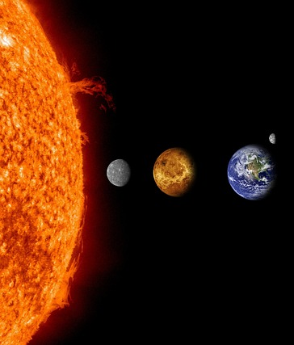

Writing large numbers in standard form
The distance from the Earth to the Sun is approximately 150 billion metres.
Let’s use a place value chart to show what this number would look like.

Slide 13
Writing large numbers in standard form
The distance from the Earth to the Sun is approximately 150 billion metres.
HB
TB
B
HM
TM
M
HTh
TTh
Th
H
T
O
t
10¹¹
10¹⁰
10⁹
10⁸
10⁷
10⁶
10⁵
10⁴
10³
10²
10¹
10⁰
10⁻¹
1 5 0 0 0 0 0 0 0 0 0 0
Inserting the number in the place value chart,
what do you think it is in standard form?

Slide 14
Writing large numbers in standard form
Writing it in standard form gives 1.5 × 10¹¹
HB
TB
B
HM
TM
M
HTh
TTh
Th
H
T
O
t
10¹¹
10¹⁰
10⁹
10⁸
10⁷
10⁶
10⁵
10⁴
10³
10²
10¹
10⁰
10⁻¹
1 5 0 0 0 0 0 0 0 0 0 0
The distance from the Earth to the Sun is approximately 150 billion metres.

Slide 15
Writing large numbers in standard form
Using a place value chart is an excellent way to visualise the number and convert to standard form, but it does take time.
Let’s see if we can find a way without the place value chart.
HB
TB
B
HM
TM
M
HTh
TTh
Th
H
T
O
t
10¹¹
10¹⁰
10⁹
10⁸
10⁷
10⁶
10⁵
10⁴
10³
10²
10¹
10⁰
10⁻¹
1 5 0 0 0 0 0 0 0 0 0 0

Slide 16
Writing large numbers in standard form
The first significant figure goes in the ones column and the other digits accordingly.
What do we multiply 1.5 by to give 150 billion?
10¹¹
HB
TB
B
HM
TM
M
HTh
TTh
Th
H
T
O
t
10¹¹
10¹⁰
10⁹
10⁸
10⁷
10⁶
10⁵
10⁴
10³
10²
10¹
10⁰
10⁻¹
1 5 0 0 0 0 0 0 0 0 0 0
1 5

Slide 17
Writing large numbers in standard form
Without the place value chart, how else could you find the exponent of 11?
It is the number of multiplications of 10 needed for the digit in the ones column to be in the correct column. Let’s count.
1 5 0 0 0 0 0 0 0 0 0 0
1 5

Slide 18
Writing large numbers in standard form
There are 11 multiplications by 10 needed from the ones column.
1 ≤ A < 10
So the answer is 1.5 × 10¹¹
1 5 0 0 0 0 0 0 0 0 0 0
1 5

Slide 19
Writing large numbers in standard form
Without a place value chart, write 956 000 000 in standard form.
956 000 000
9.56
To help visualise, line up the digits in the ones column

Slide 20
Writing large numbers in standard form
Without a place value chart, write 956 000 000 in standard form.
956 000 000
9.56
How many multiplications of 10?

Slide 21
Writing large numbers in standard form
Without a place value chart, write 956 000 000 in standard form.
956 000 000
9.56
Without a place value chart, write 780 000 in standard form.
780 000
7.8
To help visualise, line up the digits in the ones column
There were 8 multiplications of 10 from the ones column.
9.56 × 10⁸

Slide 22
Writing large numbers in standard form
Without a place value chart, write 956 000 000 in standard form.
956 000 000
9.56
Without a place value chart, write 780 000 in standard form.
780 000
7.8
How many jumps or multiplications of 10?
There were 8 multiplications of 10 from the ones column.
9.56 × 10⁸

Slide 23
Writing large numbers in standard form
Without a place value chart, write 956 000 000 in standard form.
956 000 000
9.56
Without a place value chart, write 780 000 in standard form.
780 000
7.8
There were 8 multiplications of 10 from the ones column.
There were 5 multiplications of 10 from the ones column.
9.56 × 10⁸
7.8 × 10⁵

Slide 24
Writing large numbers in standard form
Without using a place value chart, convert the following into standard form.
15 000
566 000 000
9 800 000 000
156 100
563 000 000 000 000 000
100 200 000 000

Slide 25
Writing large numbers in standard form
2) Three pupils we give 905 000 000 000 to convert to standard form. Identify where they made their error and give the correct answer.
905 000 000 000
Answer: 905 × 10⁹
905 000 000 000
Answer: 9.5 × 10¹¹
905 000 000 000
Answer: 9.05 × 10¹⁰

Slide 26
Writing large numbers in standard form
3) Explain why standard form is important.

Slide 27
Writing large numbers in standard form
Without using a place value chart, convert the following into standard form.
= 1.5 × 10⁴
15 000
566 000 000
9 800 000 000
156 100
563 000 000 000 000 000
100 200 000 000
= 5.66 × 10⁸
= 9.8 × 10⁹
= 1.561 × 10⁵
= 5.63 × 10¹⁷
= 1.002 × 10¹¹

Slide 28
Writing large numbers in standard form
2) Three pupils we give 905 000 000 000 to convert to standard form. Identify where they made their error and give the correct answer.
905 000 000 000
Answer: 905 × 10⁹
905 000 000 000
Answer: 9.5 × 10¹¹
905 000 000 000
Answer: 9.05 × 10¹⁰
The first part of standard form must have a number between 1 and 10, including 1 and not including 10.
(1 ≤ A < 10)
Incorrectly counted the number of multiplications of 10. There are 11 multiplications of 10.
In order to correctly obtain 905 000 000 000, there must be a multiplication of powers of 10 to 9.05 not 9.5
Correct: 9.05 × 10¹¹

Slide 29
Writing large numbers in standard form
3) Explain why standard form is important.
We write a number in standard form because it is easier, concise and more efficient to write numbers in this way.
It reduces errors. It would take too long to write huge numbers and there would be more room for error when writing a number in its ordinary form.
Standard form allows any number to be written using one standard approach i.e where A × 10^{n} and 1 ≤ A < 10 and n is an integer.
When writing in a concise form, it is easier to use in calculations.

Slide 30
Writing large numbers in standard form
Writing large numbers in standard form
Standard form to ordinary
Standard form on the calculator

Slide 31
Standard form to ordinary
Number | Exponential form
1
10
100
1000
10 000
100 000
1 000 000
Let’s convert a number written in standard form back into an ordinary number
Convert 2.3 × 10³ into an ordinary number.
Given × 10³ represents × 1000, we know it is
2.3 × 1000 = 2300
10⁰
10¹
10²
10³
10⁴
10⁵
10⁶

Slide 32

Standard form to ordinary
Put a tick next to the correct statements. Where the answer is incorrect, write the correct ordinary number.
5.63 × 10⁷ = 563 000 000
Correct number 56 300 000
a
2.3 × 10⁴ = 230 000
Correct number 23 000
b
7.05 × 10⁴ = 75 000
Correct number 70 500
c
d
7.02 × 10⁶ = 7 020 000

Slide 33
Standard form to ordinary
Write the following as ordinary numbers.
1.8 × 10³
1.39 × 10⁵
3.93 × 10⁷
4.413 × 10⁸
e) 8.02 × 10³
f) 5.001 × 10⁵
g) 1.2345 × 10⁷
h) 7.00004 × 10⁸

Slide 34
Standard form to ordinary
Write the following as ordinary numbers.
1.8 × 10³
1.39 × 10⁵
3.93 × 10⁷
4.413 × 10⁸
e) 8.02 × 10³
f) 5.001 × 10⁵
g) 1.2345 × 10⁷
h) 7.00004 × 10⁸
= 1 800
= 8020
= 139 000
= 500 100
= 39 300 000
= 12 345 000
= 441 300 000
= 700 004 000

Slide 35
Writing large numbers in standard form
Writing large numbers in standard form
Standard form to ordinary
Standard form on the calculator

Slide 36
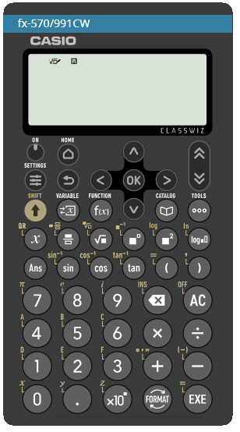
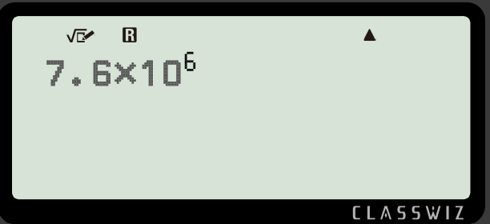
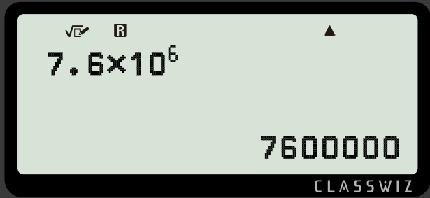

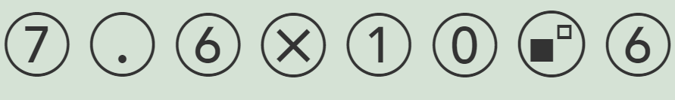

Standard form on the calculator
Let’s now use a calculator to convert
7.6 × 10⁶ into an ordinary number
Using input
Pressing or
gives the output to be
7 600 000

Slide 37

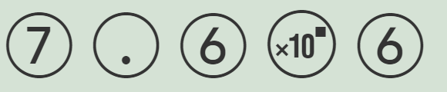
Standard form on the calculator
For example, let’s input
7.6 × 10⁶
Using input
Pressing or
gives the output to be
7 600 000

Slide 38
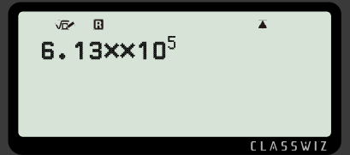

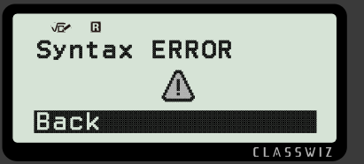
Standard form on the calculator
Laura inputs this calculation into the calculator.
What do you think the output will be?
Laura has used two multiplications so the output is an error.

Slide 39
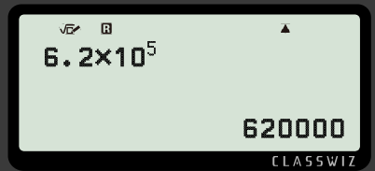
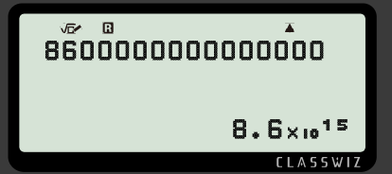
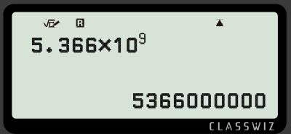
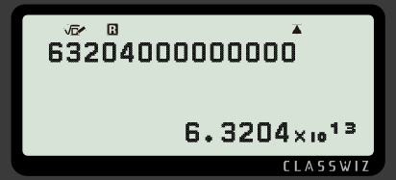
Standard form on the calculator
Fill in the missing information.
a)
c)
b)
d)

Slide 40
Standard form on the calculator
2) Investigate when the number becomes so big that the calculator converts it into standard form.

Slide 41
Standard form on the calculator
Fill in the missing information.
a)
c)
b)
d)

Slide 42
Standard form on the calculator
2) Investigate when the number becomes so big that the calculator converts it into standard form.
Any integer on the screen which has more than 9 digits will be converted into standard form.

Slide 43
Writing large numbers in standard form
We write a number in standard form because it is easier, concise and more efficient to write numbers in this way.
If we do not write large numbers in standard form, it would take too long to write huge numbers and there would be more room for error when writing a number in its ordinary form.
Standard form allows any number to be written using one standard approach i.e A × 10^{n}, (where 1 ≤ A < 10 and n is an integer).

Slide 44

© Oak National Academy 2024.
Produced in partnership with Mathematics in Education and Industry.
Licensed on the Open Government Licence v3.0, except where otherwise stated. See Oak terms and conditions.

